Slide 1




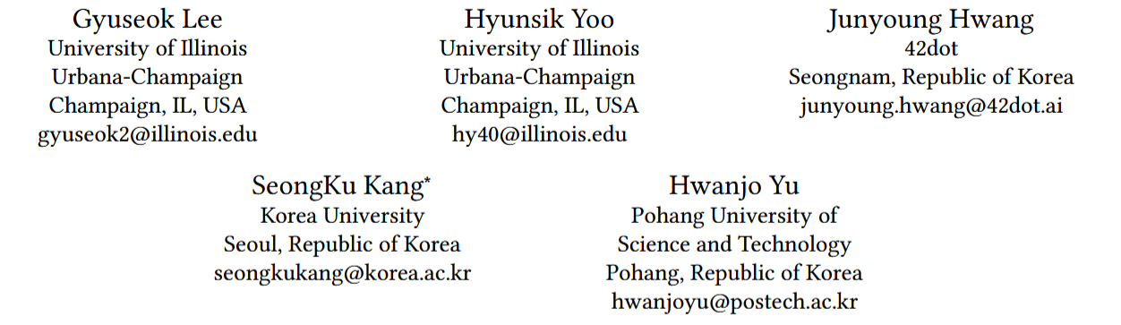





ATAI
Advanced Technique of Artificial Intelligence
ATAI
ChongqingUniversity _{AdvancedTechniqueof}
of Technology Artificial Intelligence
Chongqing University of
Technology
Chongqing University ^{ATAI}
_{of Technology} Advanced Techniqueof
Artificial Intelligence
Chongqing University of Technology
Chongqing University of Technology
Capturing User Interests from Data Streams for Continual Sequential Recommendation
https://github.com/Gyu-Seok0/CSTRec_WSDM26
——WSDM_2026
Reported by Jingbo Liu
1

Slide 2
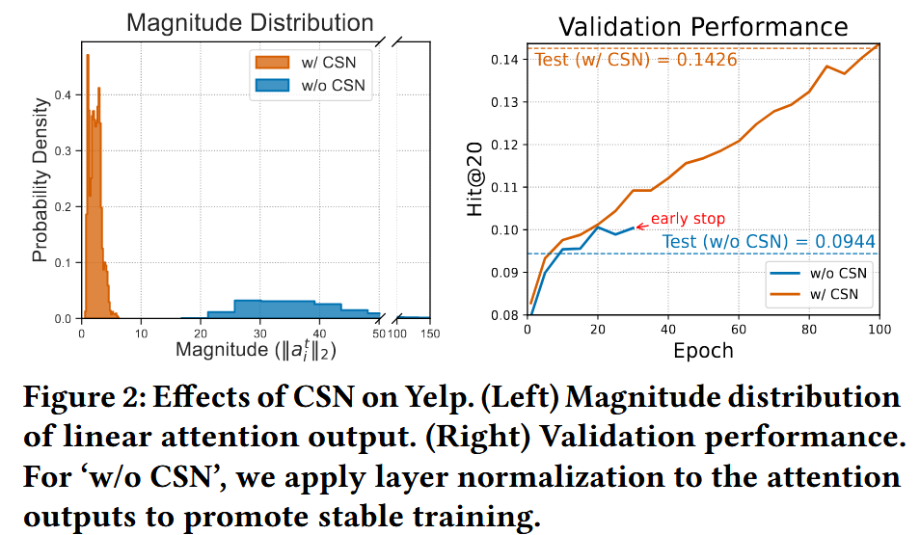
ATAI
Advanced Technique of Artificial Intelligence
ATAI
ChongqingUniversity _{AdvancedTechniqueof}
of Technology Artificial Intelligence
Chongqing University of
Technology
Chongqing University ^{ATAI}
_{of Technology} Advanced Techniqueof
Artificial Intelligence
Chongqing University of Technology
Chongqing University of Technology
Motivation
Although continual learning has been applied to recommendation, existing methods gradually forget long-term user preferences and remain underexplored in SR.
2) unstable training , hidden states accumulate user behaviors over time, resulting in disproportionately large values for active users and small values for less active users
3) inevitable forgetting, caused by the continual update of hidden states with new sequences over time. This causes historical knowledge to be continuously overwritten and gradually forgotten.

Slide 3


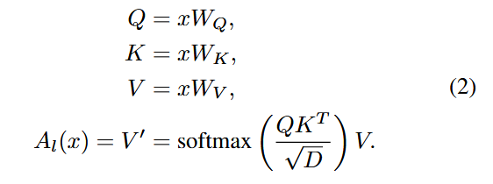
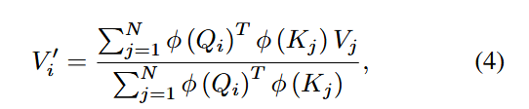
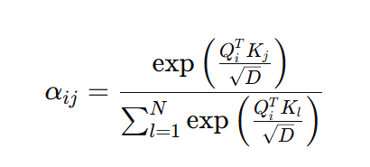
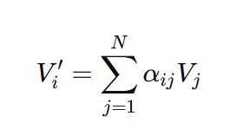
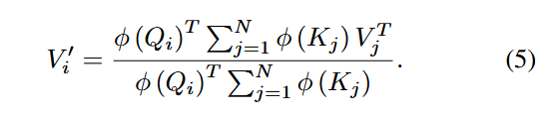
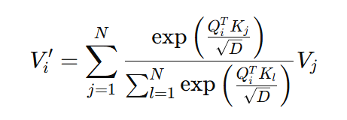

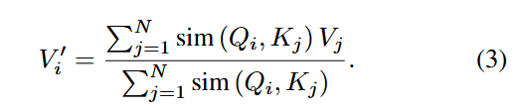

ATAI
Advanced Technique of Artificial Intelligence
ATAI
ChongqingUniversity _{AdvancedTechniqueof}
of Technology Artificial Intelligence
Chongqing University of
Technology
Chongqing University ^{ATAI}
_{of Technology} Advanced Techniqueof
Artificial Intelligence
Chongqing University of Technology
Chongqing University of Technology
Motivation
2020_ICML_Transformers are RNNs: Fast Autoregressive Transformers with Linear Attention

Slide 4
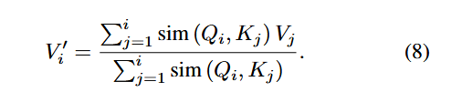
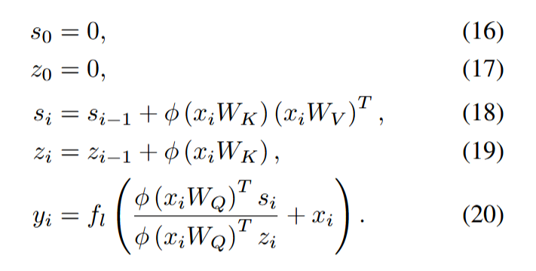

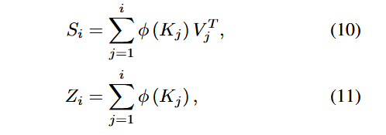

ATAI
Advanced Technique of Artificial Intelligence
ATAI
ChongqingUniversity _{AdvancedTechniqueof}
of Technology Artificial Intelligence
Chongqing University of
Technology
Chongqing University ^{ATAI}
_{of Technology} Advanced Techniqueof
Artificial Intelligence
Chongqing University of Technology
Chongqing University of Technology
Motivation
2020_ICML_Transformers are RNNs: Fast Autoregressive Transformers with Linear Attention

Slide 5
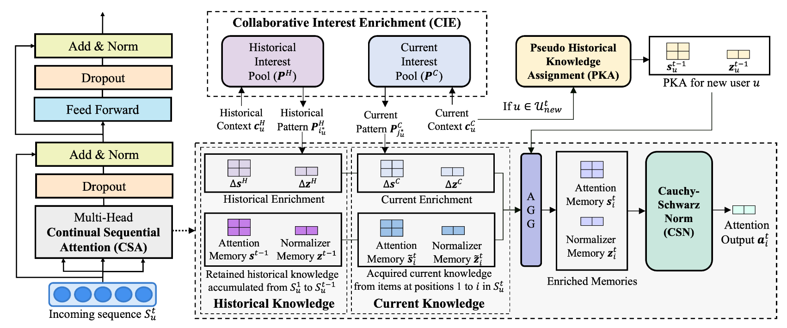
ATAI
ChongqingUniversity _{AdvancedTechniqueof}
of Technology Artificial Intelligence
Chongqing University of
Technology
ATAI
Advanced Technique of Artificial Intelligence
Chongqing University ^{ATAI}
_{of Technology} Advanced Techniqueof
Artificial Intelligence
Chongqing University of Technology
Chongqing University of Technology
Method

Slide 6
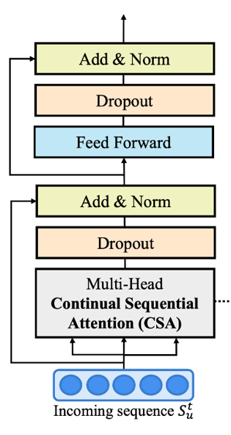
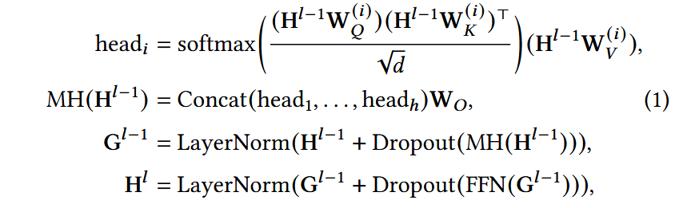
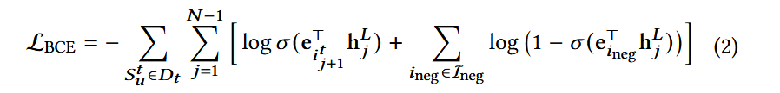
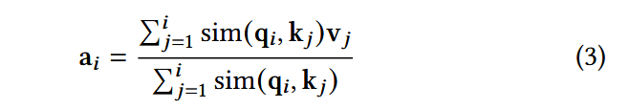
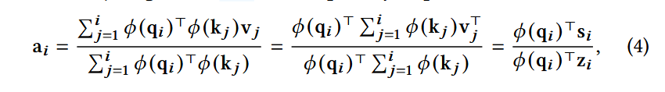
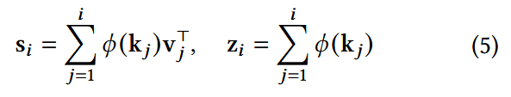
ATAI
Advanced Technique of Artificial Intelligence
ATAI
ChongqingUniversity _{AdvancedTechniqueof}
of Technology Artificial Intelligence
Chongqing University of
Technology
Chongqing University ^{ATAI}
_{of Technology} Advanced Techniqueof
Artificial Intelligence
Chongqing University of Technology
Chongqing University of Technology
Method

Slide 7




ATAI
Advanced Technique of Artificial Intelligence
ATAI
ChongqingUniversity _{AdvancedTechniqueof}
of Technology Artificial Intelligence
Chongqing University of
Technology
Chongqing University ^{ATAI}
_{of Technology} Advanced Techniqueof
Artificial Intelligence
Chongqing University of Technology
Chongqing University of Technology
Method

Slide 8
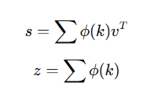


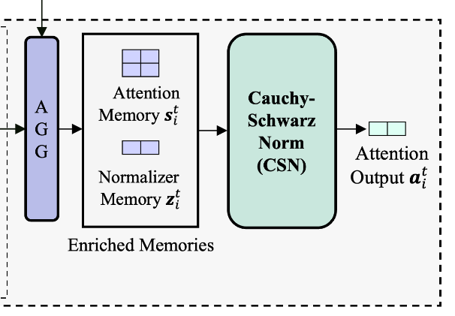






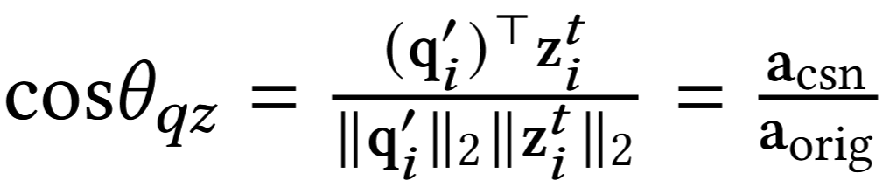

ATAI
Advanced Technique of Artificial Intelligence
ATAI
ChongqingUniversity _{AdvancedTechniqueof}
of Technology Artificial Intelligence
Chongqing University of
Technology
Chongqing University ^{ATAI}
_{of Technology} Advanced Techniqueof
Artificial Intelligence
Chongqing University of Technology
Chongqing University of Technology
Method

Slide 9
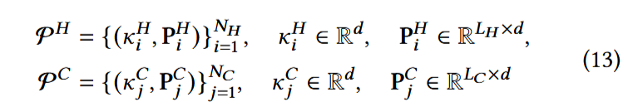
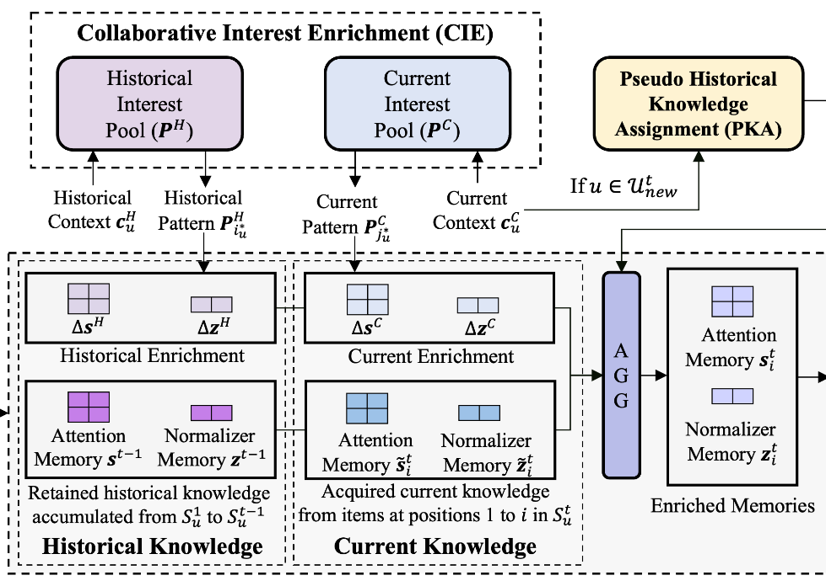

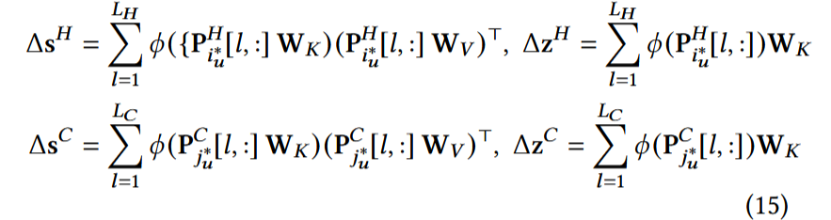
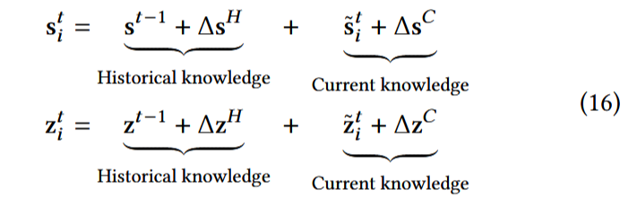
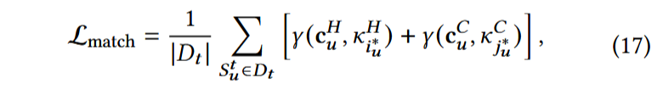
ATAI
Advanced Technique of Artificial Intelligence
ATAI
ChongqingUniversity _{AdvancedTechniqueof}
of Technology Artificial Intelligence
Chongqing University of
Technology
Chongqing University ^{ATAI}
_{of Technology} Advanced Techniqueof
Artificial Intelligence
Chongqing University of Technology
Chongqing University of Technology
Method

Slide 10



ATAI
Advanced Technique of Artificial Intelligence
ATAI
ChongqingUniversity _{AdvancedTechniqueof}
of Technology Artificial Intelligence
Chongqing University of
Technology
Chongqing University ^{ATAI}
_{of Technology} Advanced Techniqueof
Artificial Intelligence
Chongqing University of Technology
Chongqing University of Technology
Method

Slide 11
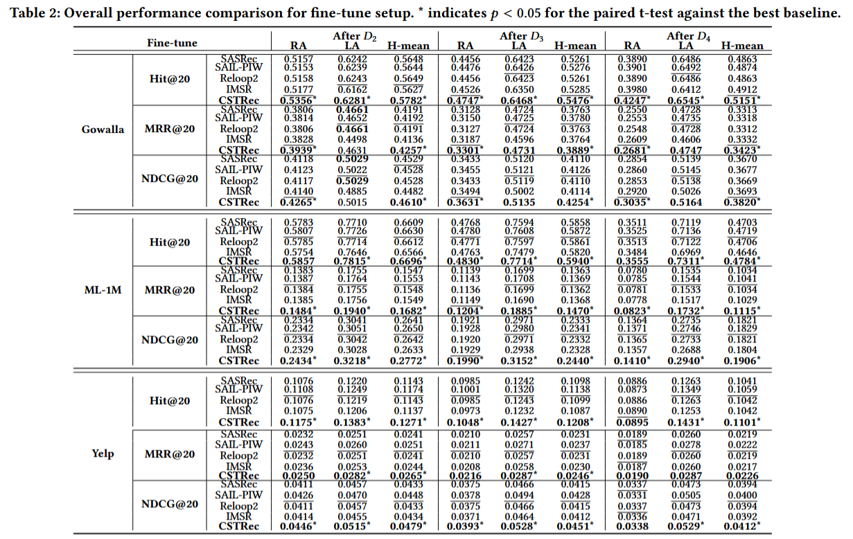
ATAI
Advanced Technique of Artificial Intelligence
ATAI
ChongqingUniversity _{AdvancedTechniqueof}
of Technology Artificial Intelligence
Chongqing University of
Technology
Chongqing University ^{ATAI}
_{of Technology} Advanced Techniqueof
Artificial Intelligence
Experiments
Chongqing University of Technology
Chongqing University of Technology

Slide 12
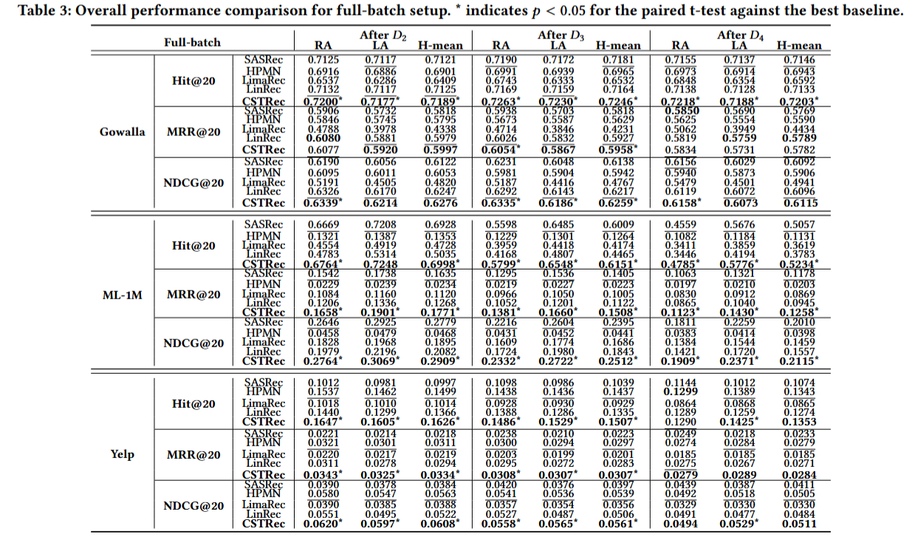
ATAI
Advanced Technique of Artificial Intelligence
ATAI
ChongqingUniversity _{AdvancedTechniqueof}
of Technology Artificial Intelligence
Chongqing University of
Technology
Chongqing University ^{ATAI}
_{of Technology} Advanced Techniqueof
Artificial Intelligence
Experiments
Chongqing University of Technology
Chongqing University of Technology

Slide 13
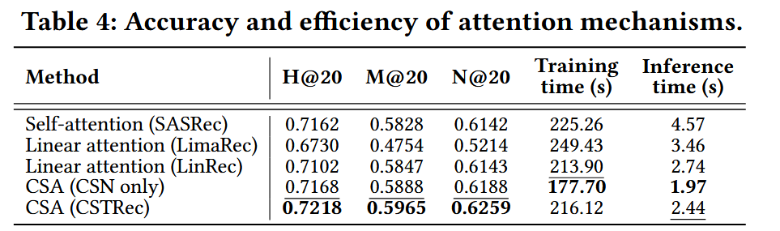
ATAI
Advanced Technique of Artificial Intelligence
ATAI
ChongqingUniversity _{AdvancedTechniqueof}
of Technology Artificial Intelligence
Chongqing University of
Technology
Chongqing University ^{ATAI}
_{of Technology} Advanced Techniqueof
Artificial Intelligence
Experiments
Chongqing University of Technology
Chongqing University of Technology

Slide 14
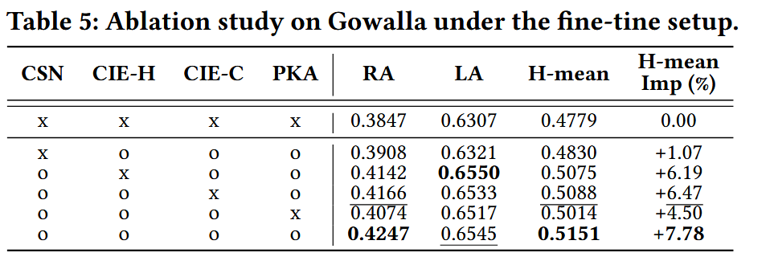
ATAI
Advanced Technique of Artificial Intelligence
ATAI
ChongqingUniversity _{AdvancedTechniqueof}
of Technology Artificial Intelligence
Chongqing University of
Technology
Chongqing University ^{ATAI}
_{of Technology} Advanced Techniqueof
Artificial Intelligence
Experiments
Chongqing University of Technology
Chongqing University of Technology

Slide 15
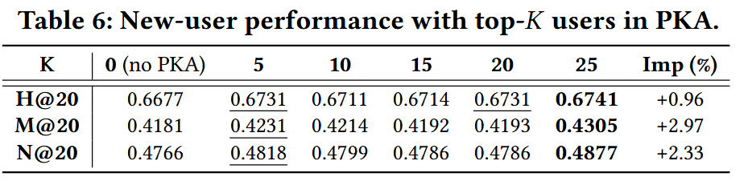
ATAI
Advanced Technique of Artificial Intelligence
ATAI
ChongqingUniversity _{AdvancedTechniqueof}
of Technology Artificial Intelligence
Chongqing University of
Technology
Chongqing University ^{ATAI}
_{of Technology} Advanced Techniqueof
Artificial Intelligence
Experiments
Chongqing University of Technology
Chongqing University of Technology

Slide 16
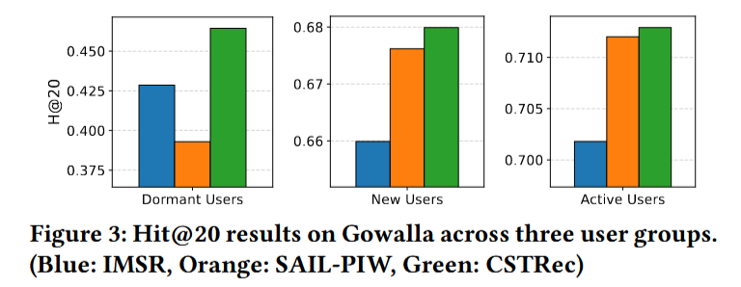
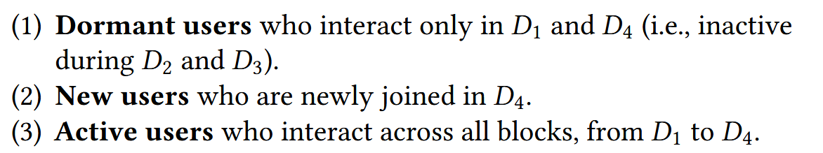
ATAI
Advanced Technique of Artificial Intelligence
ATAI
ChongqingUniversity _{AdvancedTechniqueof}
of Technology Artificial Intelligence
Chongqing University of
Technology
Chongqing University ^{ATAI}
_{of Technology} Advanced Techniqueof
Artificial Intelligence
Experiments
Chongqing University of Technology
Chongqing University of Technology

Slide 17
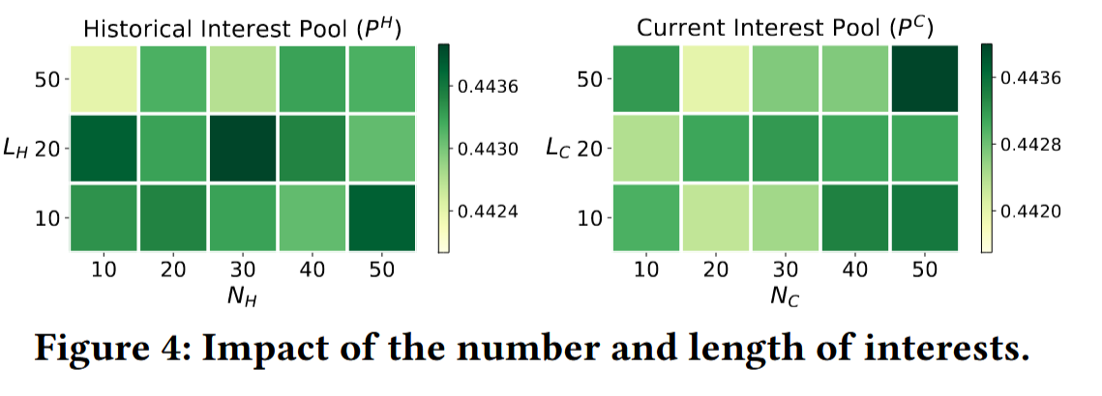
ATAI
Advanced Technique of Artificial Intelligence
ATAI
ChongqingUniversity _{AdvancedTechniqueof}
of Technology Artificial Intelligence
Chongqing University of
Technology
Chongqing University ^{ATAI}
_{of Technology} Advanced Techniqueof
Artificial Intelligence
Experiments
Chongqing University of Technology
Chongqing University of Technology

Slide 18
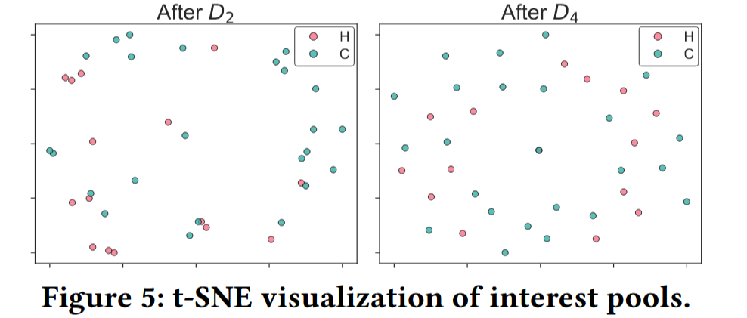
ATAI
Advanced Technique of Artificial Intelligence
ATAI
ChongqingUniversity _{AdvancedTechniqueof}
of Technology Artificial Intelligence
Chongqing University of
Technology
Chongqing University ^{ATAI}
_{of Technology} Advanced Techniqueof
Artificial Intelligence
Experiments
Chongqing University of Technology
Chongqing University of Technology

Slide 19


ATAI
Advanced Technique of Artificial Intelligence
ATAI
ChongqingUniversity _{AdvancedTechniqueof}
of Technology Artificial Intelligence
Chongqing University of
Technology
Chongqing University ^{ATAI}
_{of Technology} Advanced Techniqueof
Artificial Intelligence
Chongqing University of Technology
Chongqing University of Technology
Thanks!

